Slide 1
GOES-19 L2 (Group 2) Provisional Validation
Peer/Stakeholder Product Validation Review (PS-PVR)
Feb. 5, 2025
NWS Perspective: AWIPS verification
V Wegman & Derek van Pelt
TOWR-S team, NWS Office of Observations

Slide 2
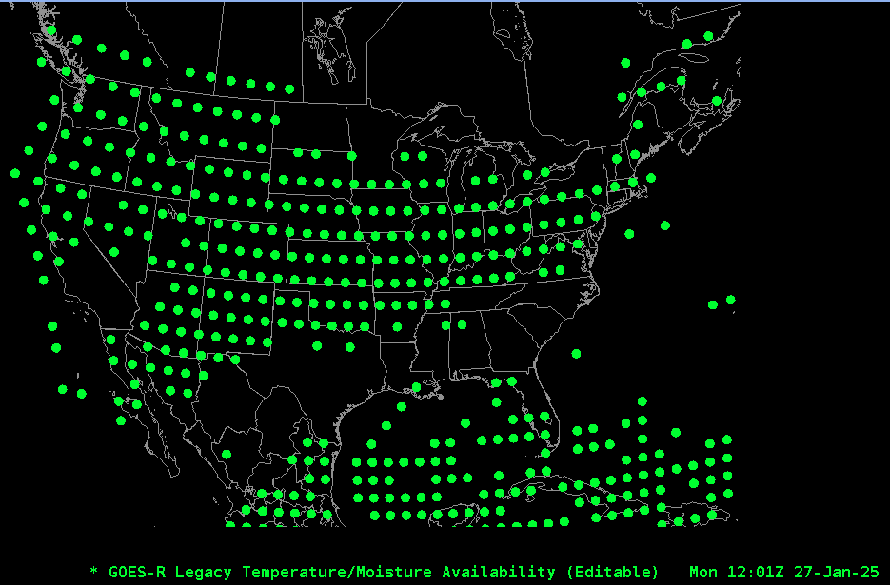
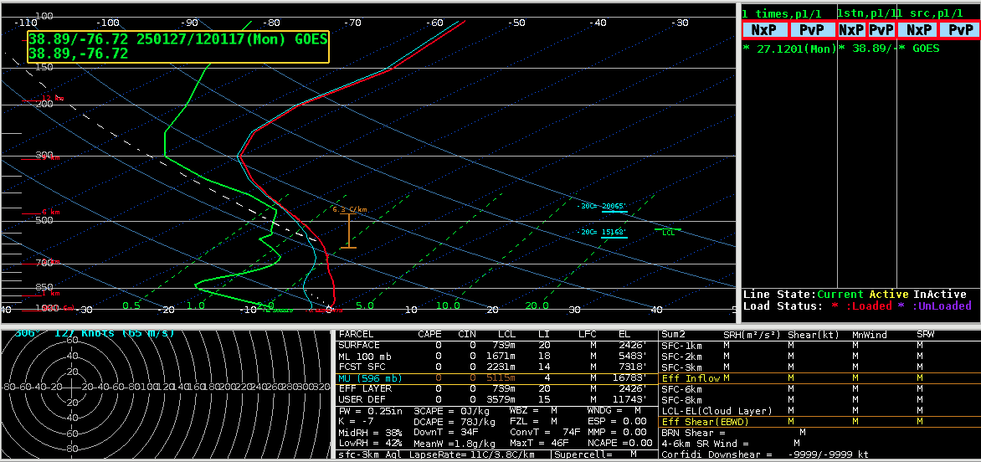
Legacy Atmospheric Profiles
GOES-19 Skew-T plot
GOES-19 Legacy Vertical Moisture and Temperature profiles (34-levels) plot map (above) OR_ABI-L2-LVMPRC-M6_G19.., and OR_ABI-L2-LVTPRC-M6_G19..)
GOES-19 Preliminary, Non-Operational Data

Slide 3
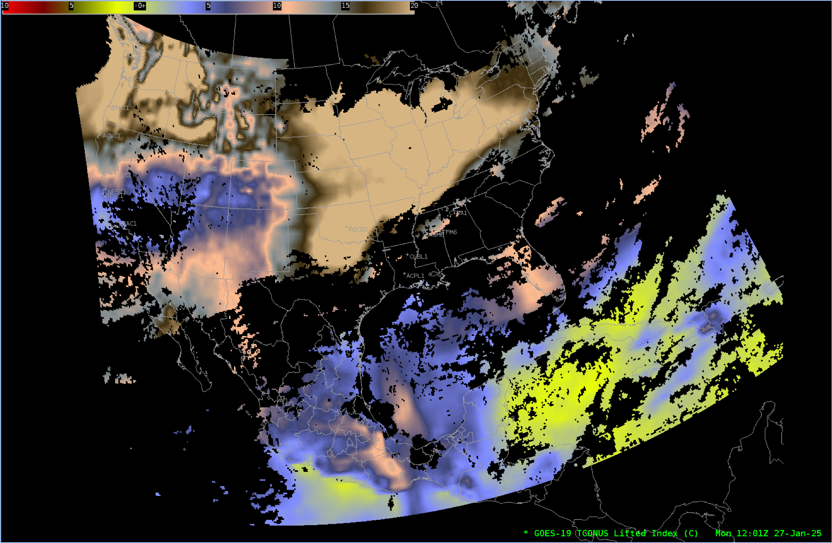
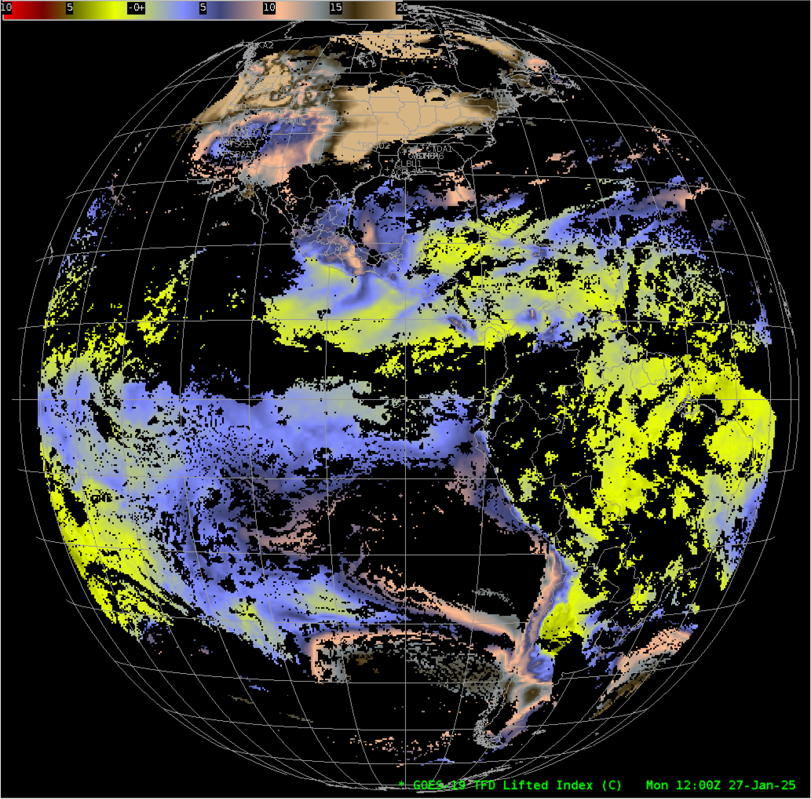
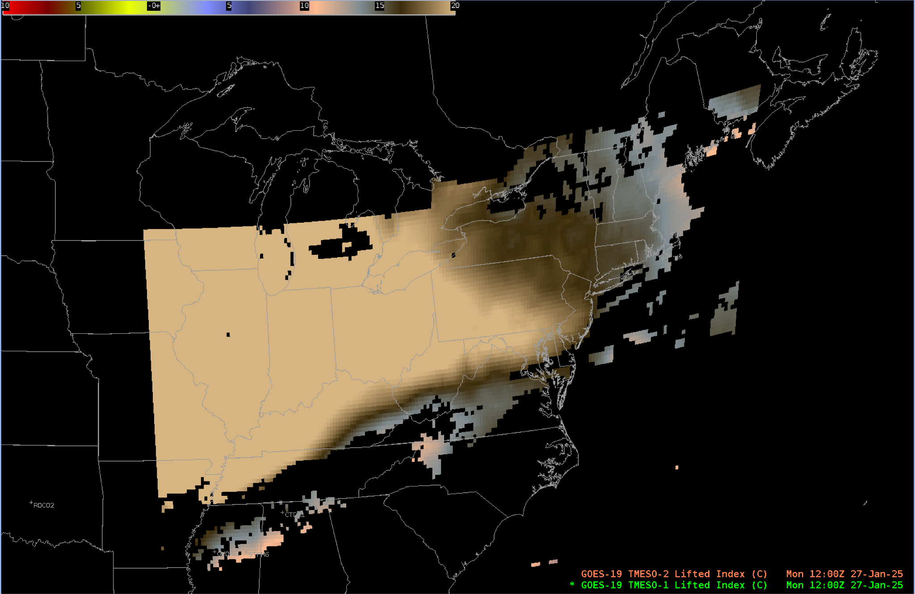
Derived Stability Indices: Lifted Index
GOES-19 Preliminary, Non-Operational Data

Slide 4
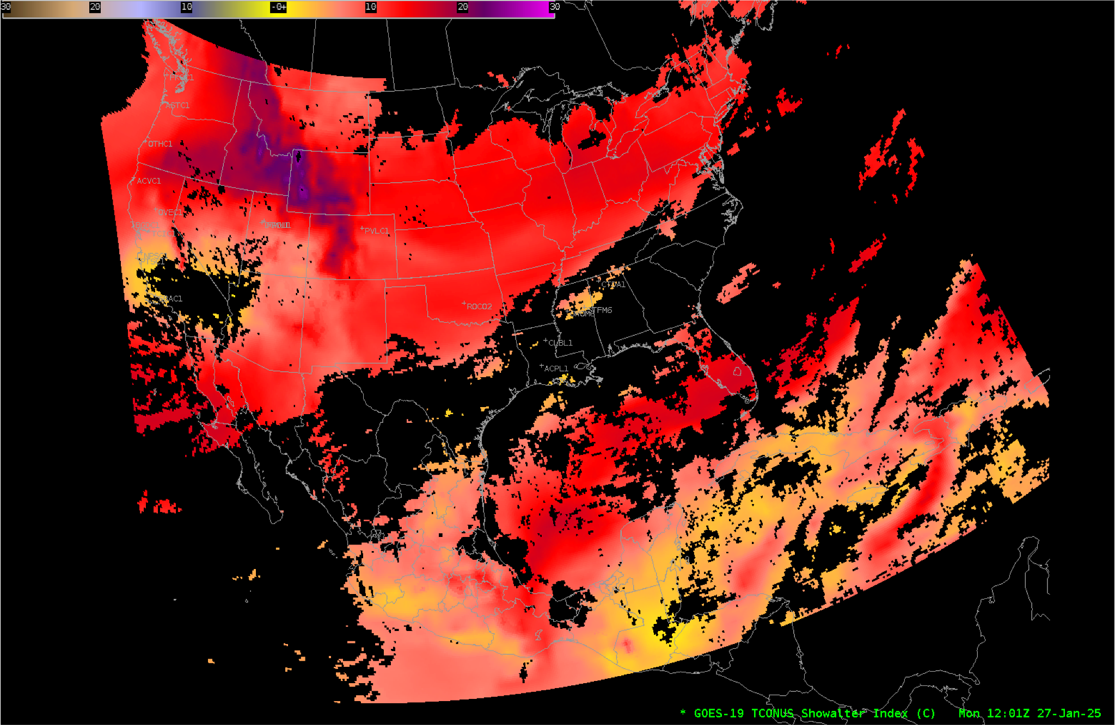
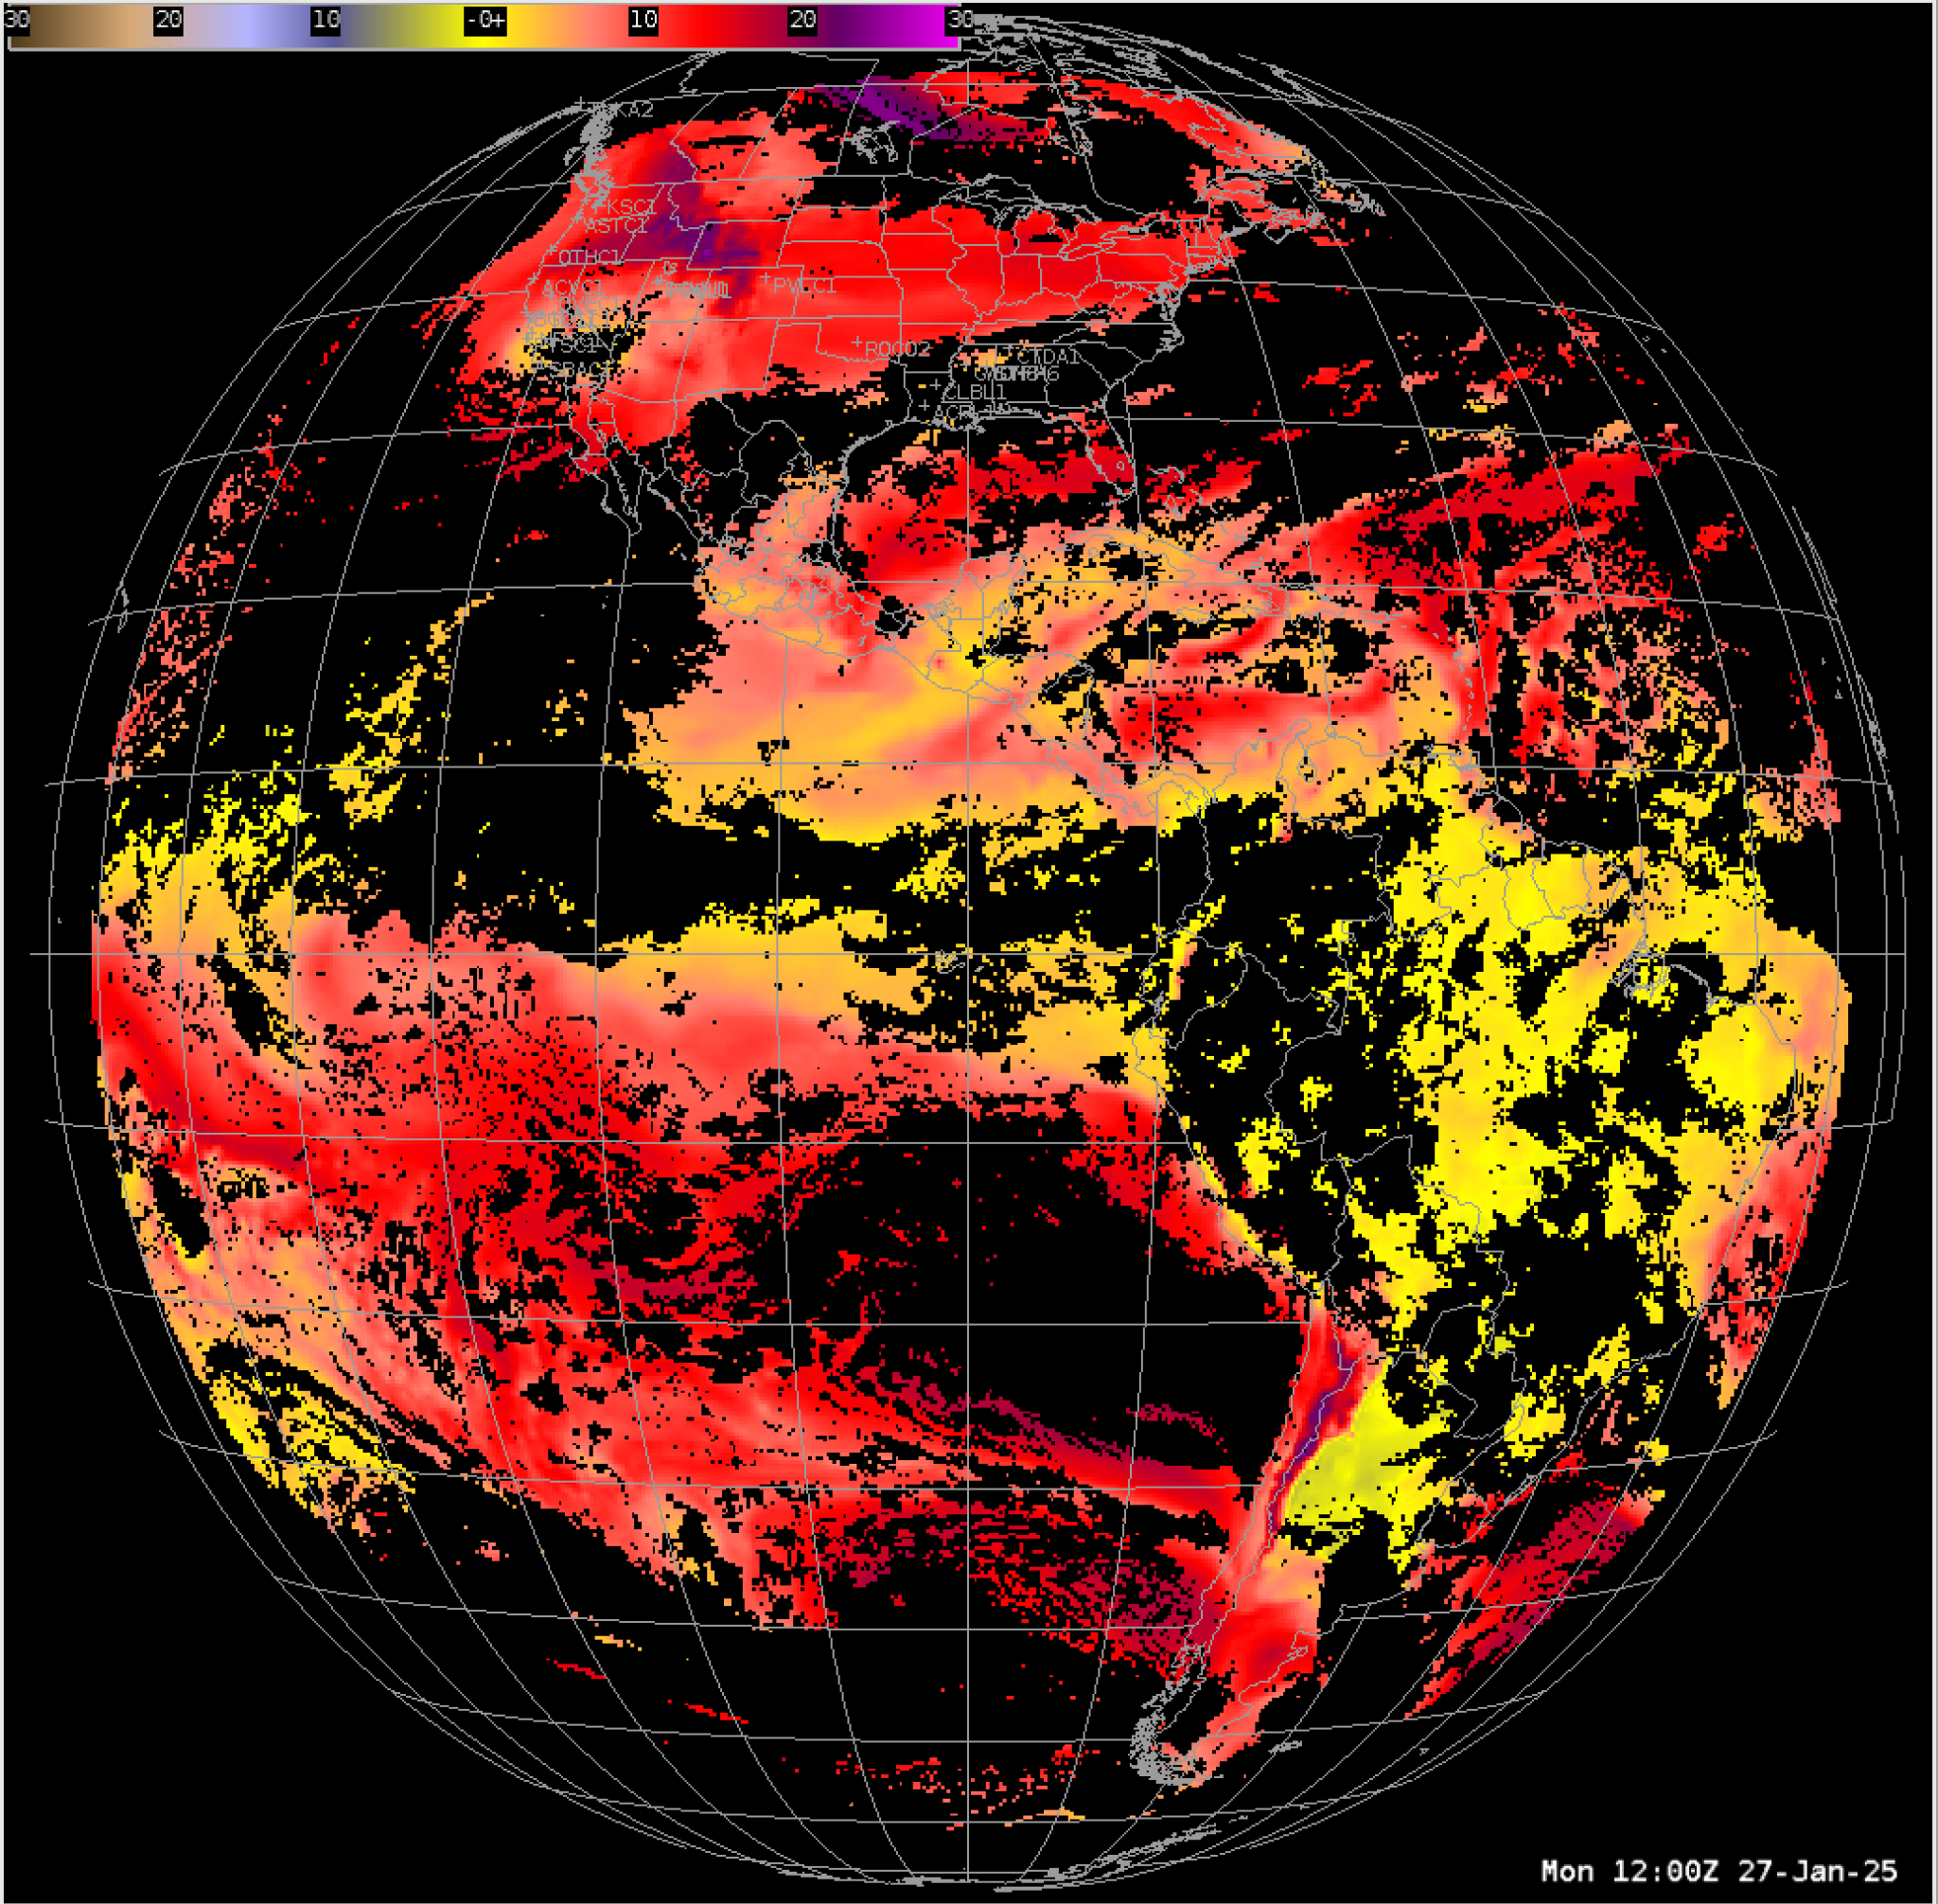
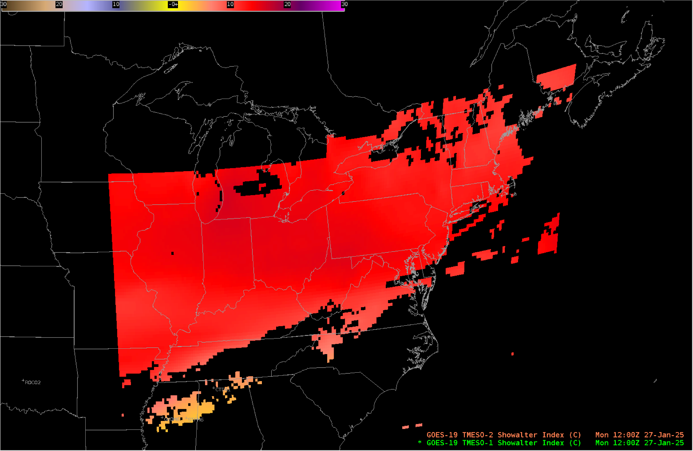
Derived Stability Indices:
Showalter Index
GOES-19 Preliminary, Non-Operational Data

Slide 5
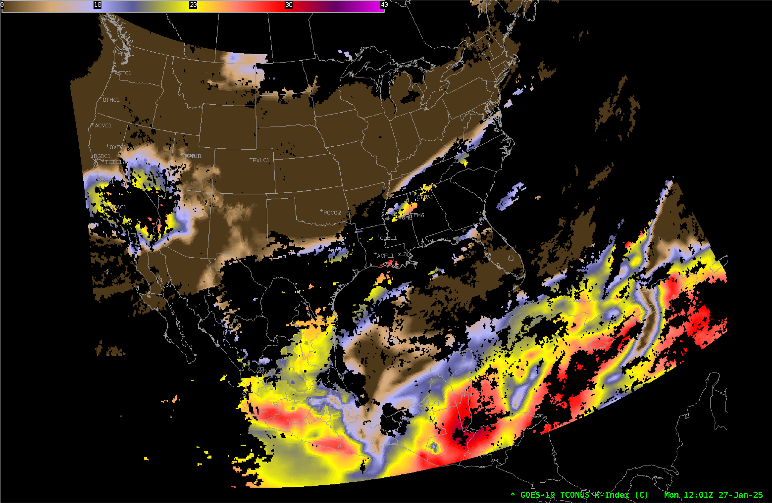
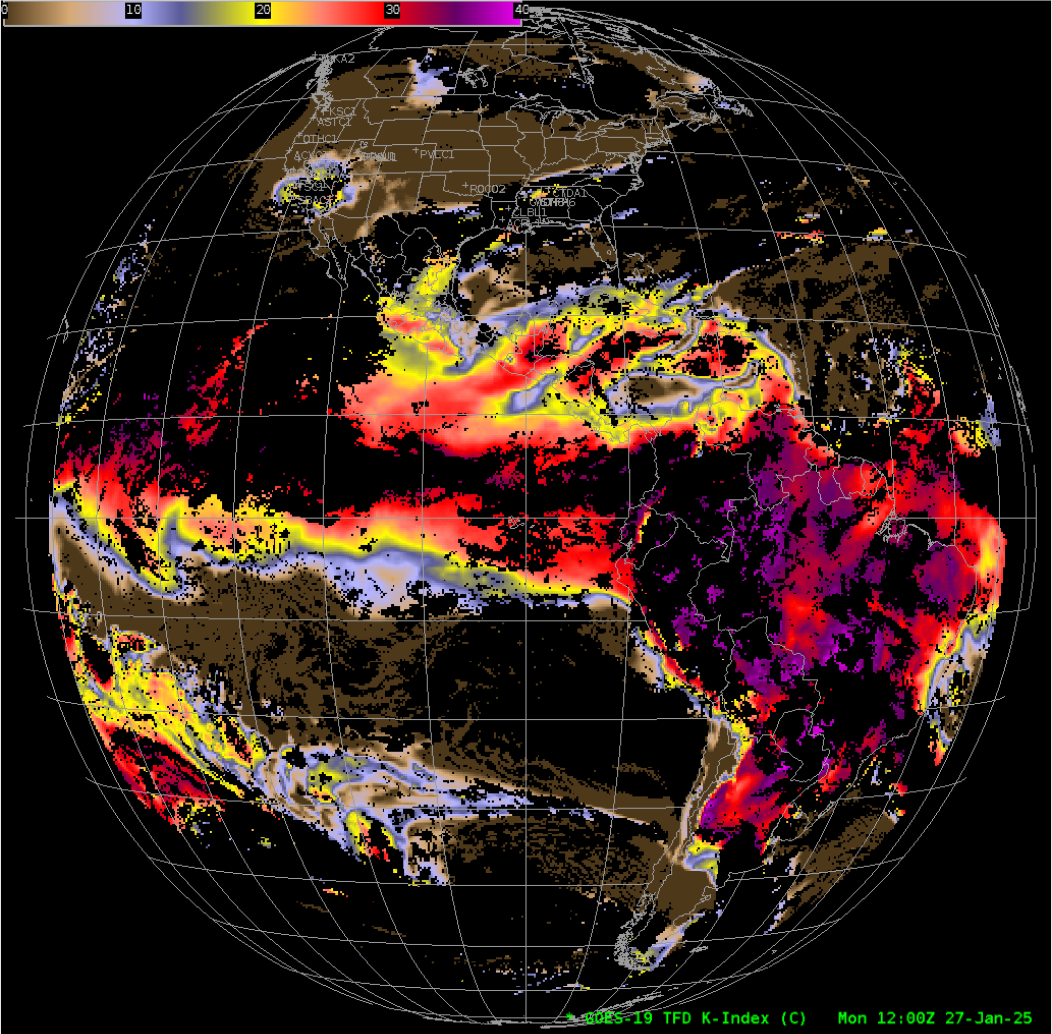
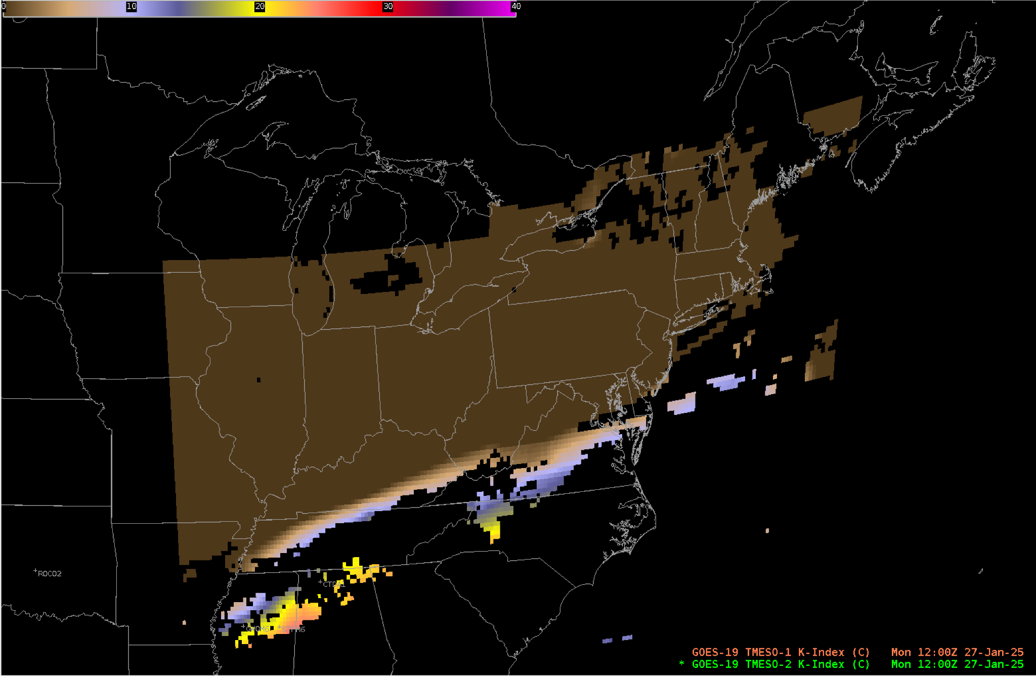
Derived Stability Indices: K-Index
GOES-19 Preliminary, Non-Operational Data

Slide 6
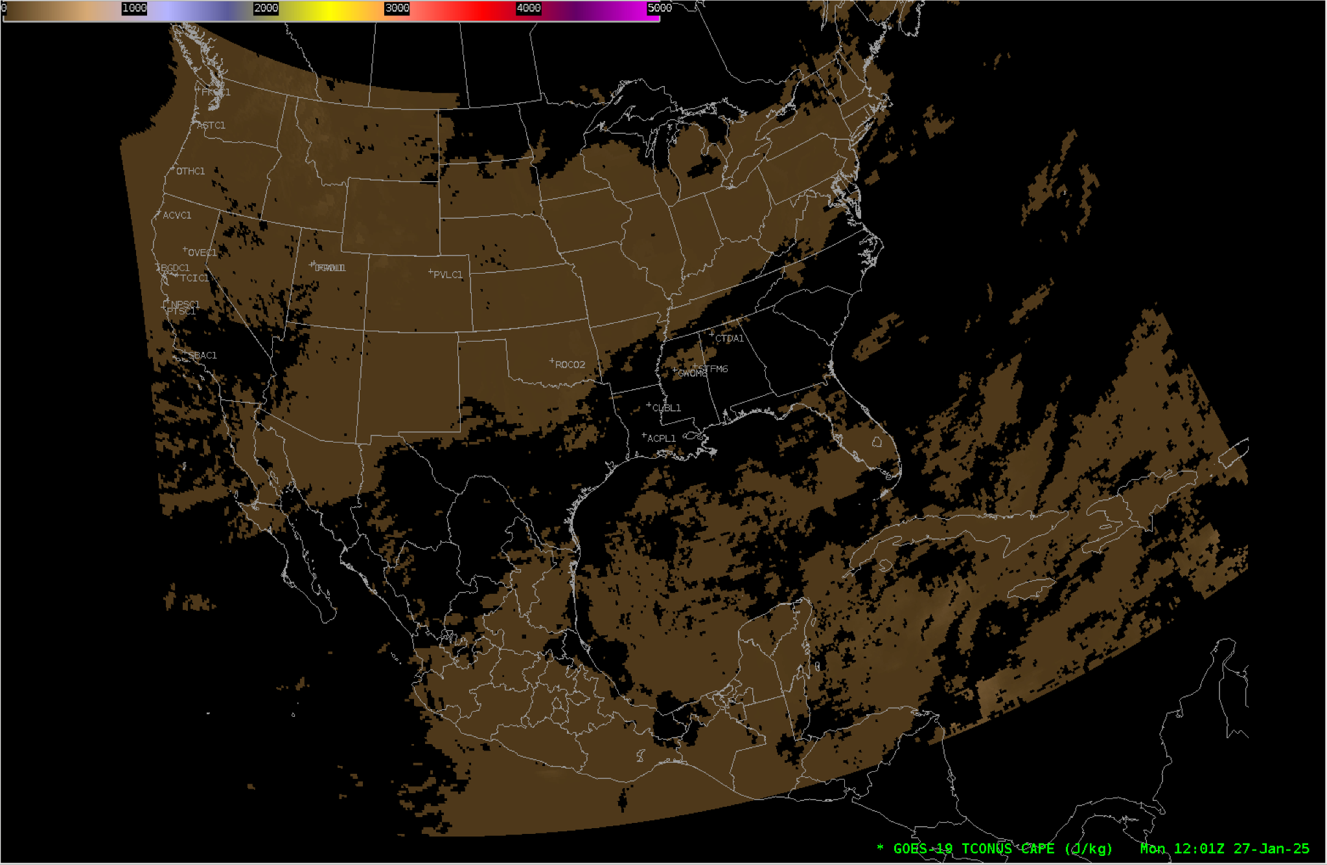
Derived Stability Indices: Convective Available Potential Energy (CAPE)
GOES-19 Preliminary, Non-Operational Data
Notes:
Not sure why the last time around we only included the CONUS image as it looks like FULL DISK and MESO are available (For Rain Rate – I only have a sample of FULL DISK – I assume that is because the others are not created?)

Slide 7
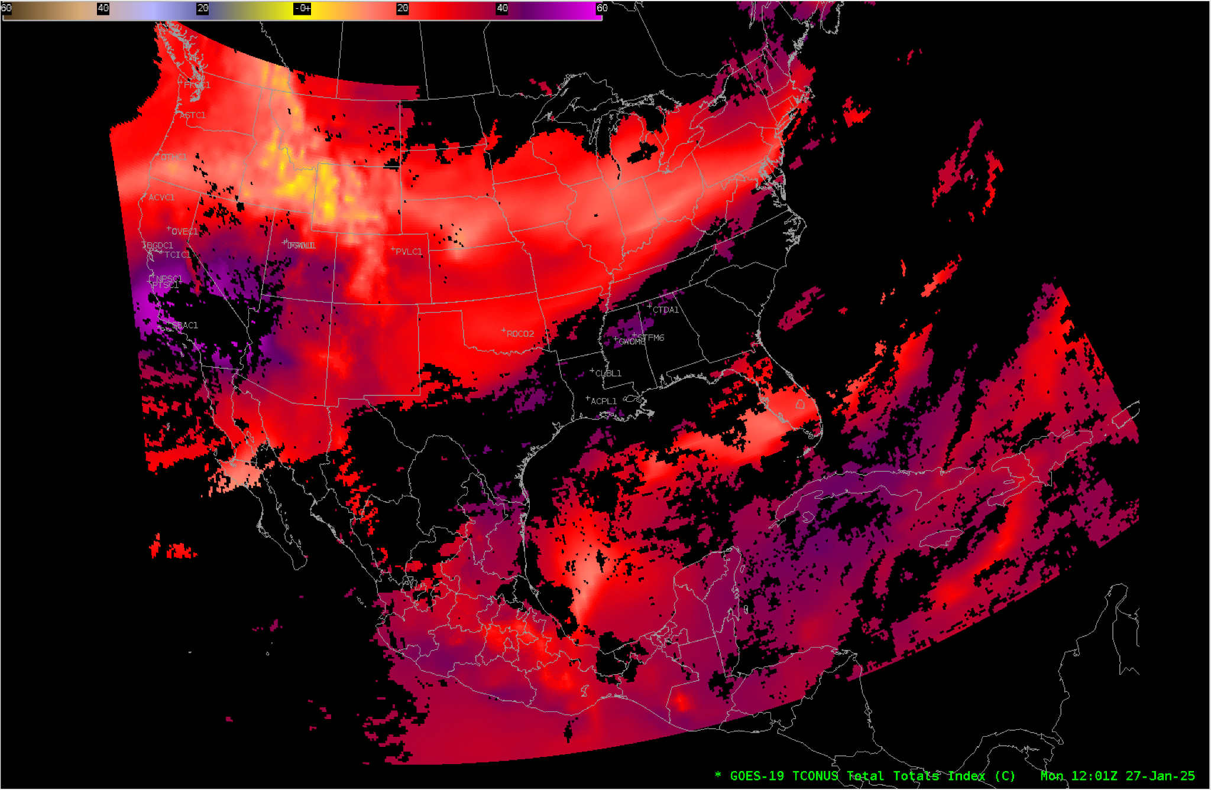
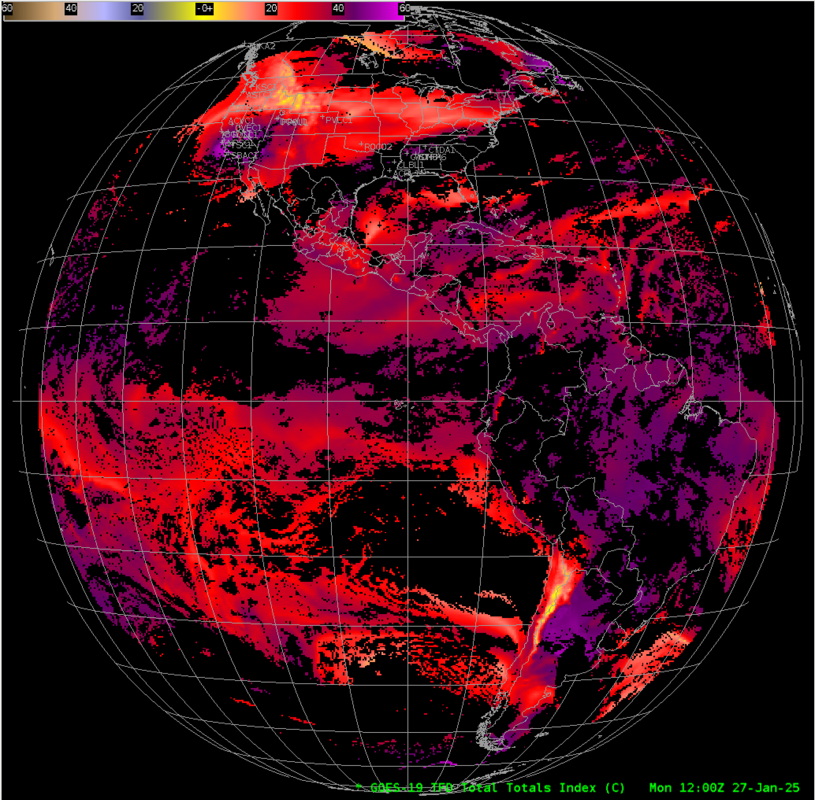
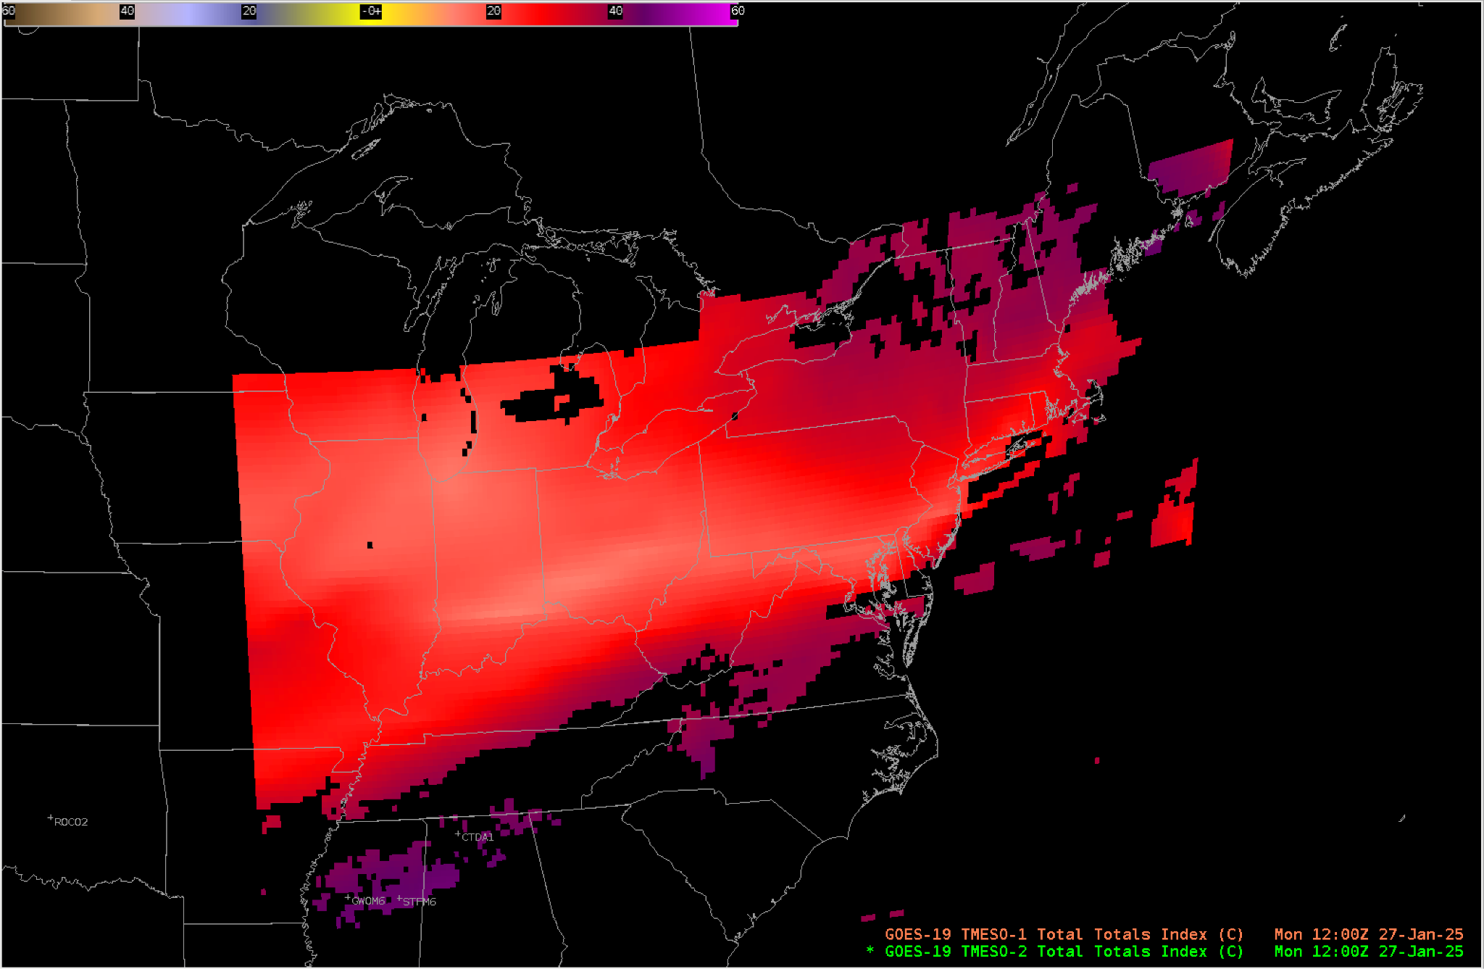
Derived Stability Indices: Total Totals Index
GOES-19 Preliminary, Non-Operational Data

Slide 8
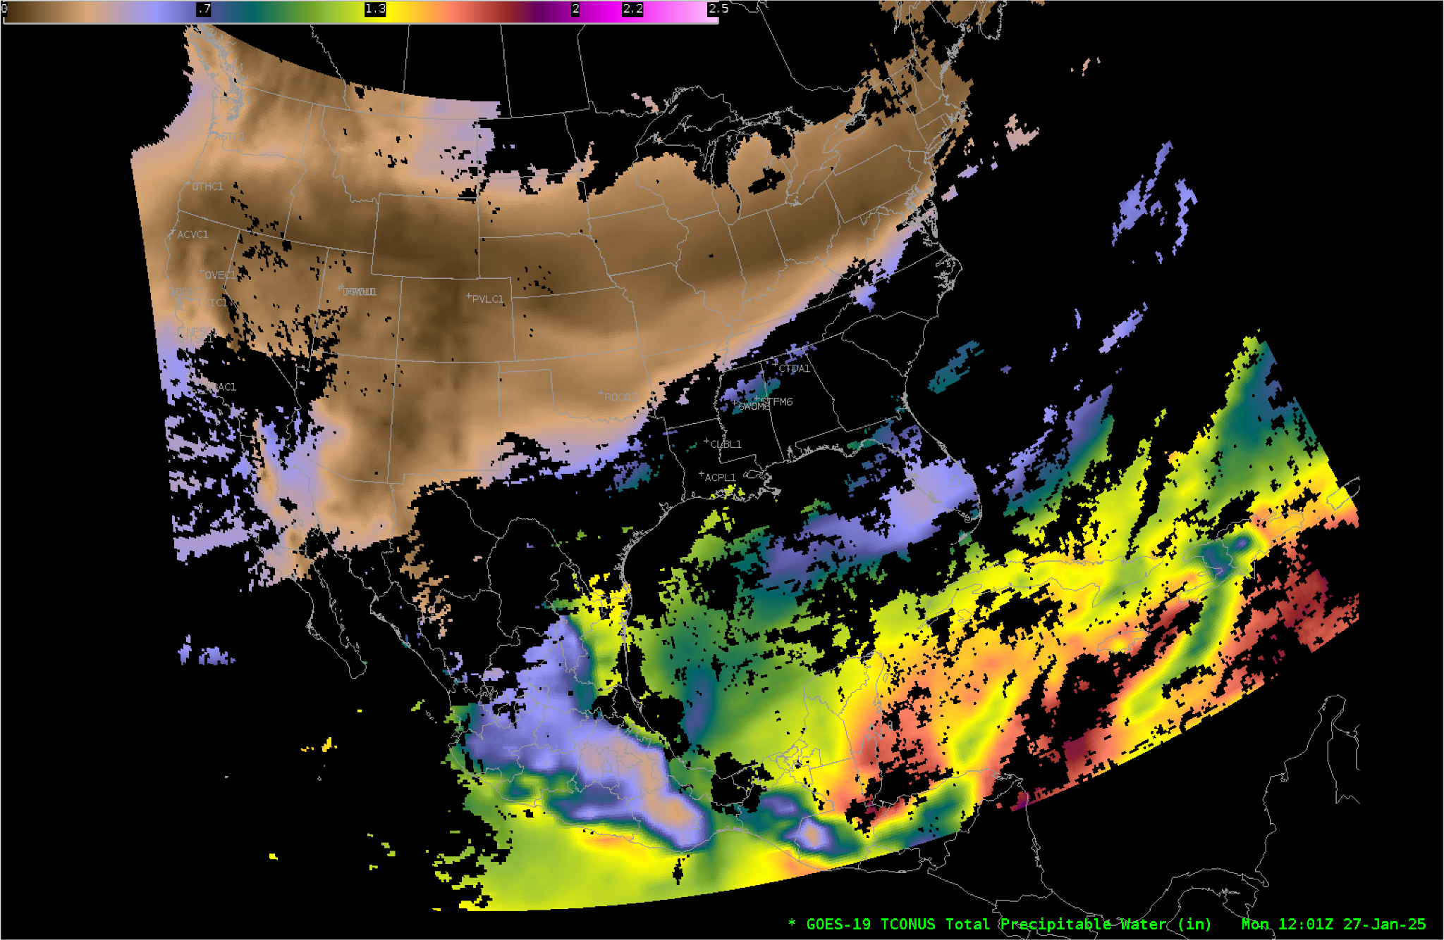
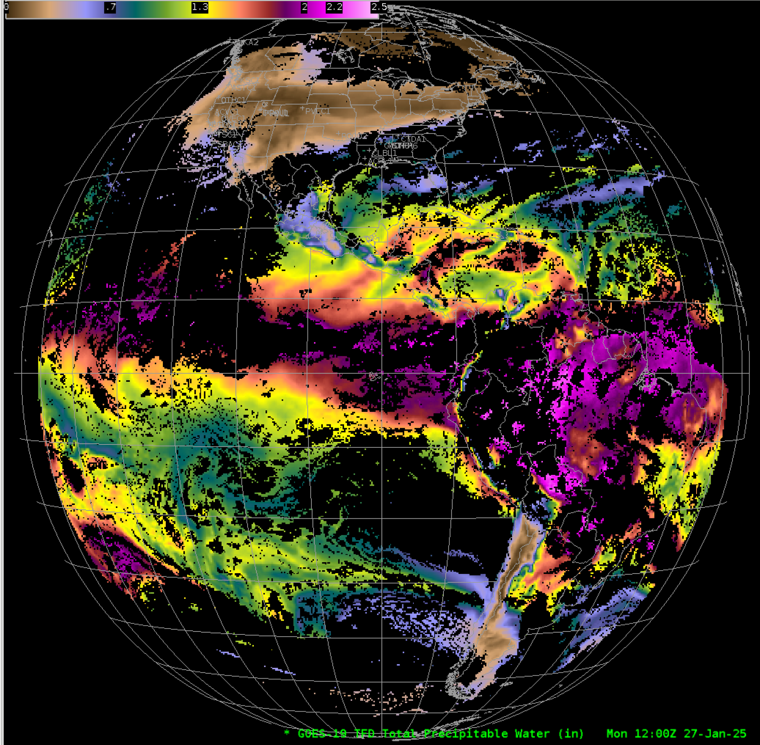
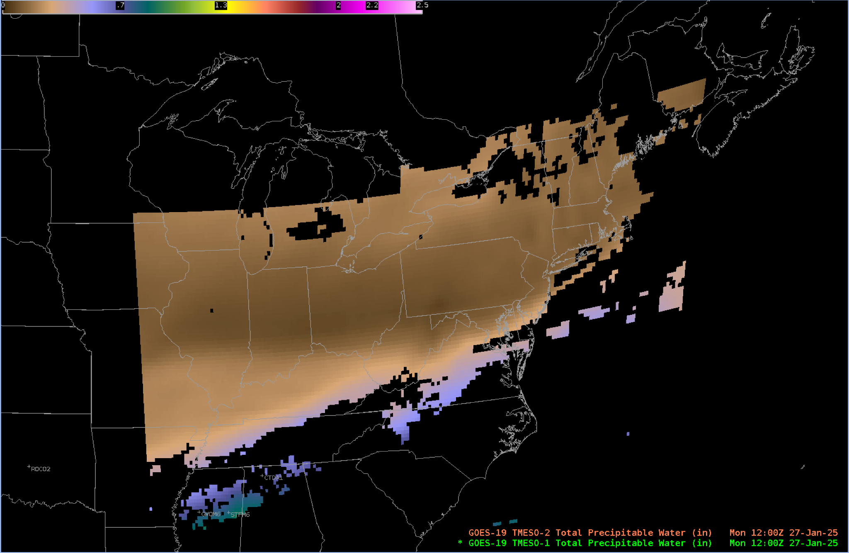
Total Precipitable Water
GOES-19 Preliminary, Non-Operational Data

Slide 9
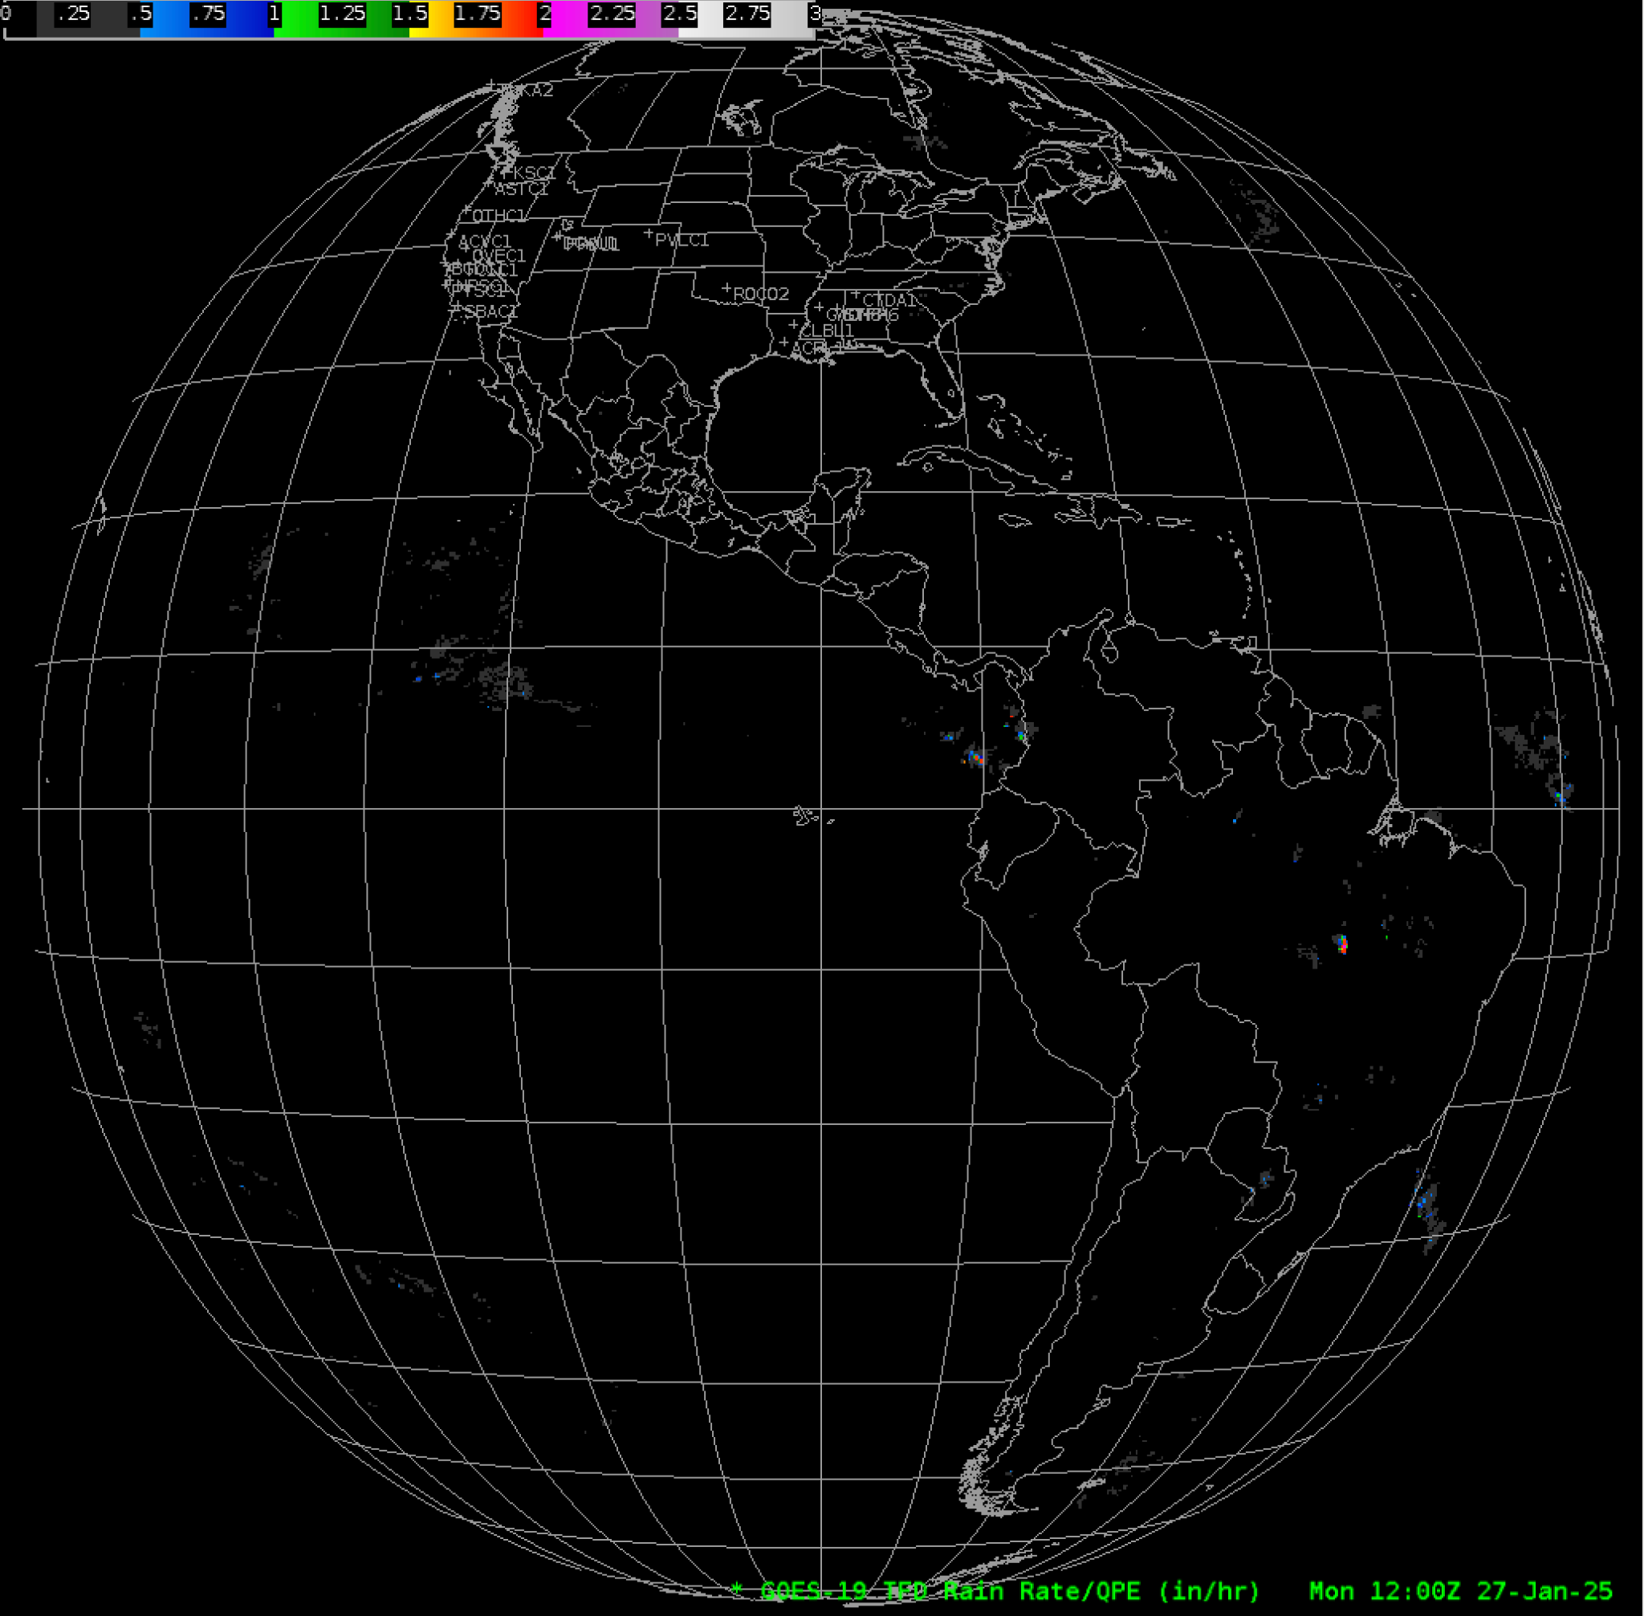
Rain Rate / Quantitative Precipitation Estimate
GOES-19 Preliminary, Non-Operational Data

Slide 10
Notes
AWIPS ingests and displays all these products using its baseline configurations.
No fielding issues are expected
G-19 products conform closely to G-16,17 conventions (GOES-R Product User Guide)
AWIPS’ baseline configurations for G16 and G18 are extensible for G19+

